Slide 1
Loan Prediction Analysis
Data Science Test – CIMB Niaga
Insight full data with visualization.
Reporter: Enggar Kristian

Slide 2
Contents
| Text
01
Introduction
02
Data Loading
03
Exploratory Data Analysis
04
Target Label
05
Data Preprocessing
06
Model Training and Model Evaluation
07
Conclusion

Slide 3


01
Enggar Kristian
Data Science
Data Engineer
Data Analytics
Bussiness Intelligence Analysis
Github
LinkedIn

Slide 4




02
Data Loading
Python
Infromation of Data
Modeling
Pandas, Scikit-learn, Seaborn, etc
We want to know what the inside of dataset with data.info()
Dataset has been ready for Exploratory Data Analyisis and Modeling
Clean the Dataset
Load the Dataset
There is a missing values and outliers in Dataset
data_train.csv and data_test.csv

Slide 5
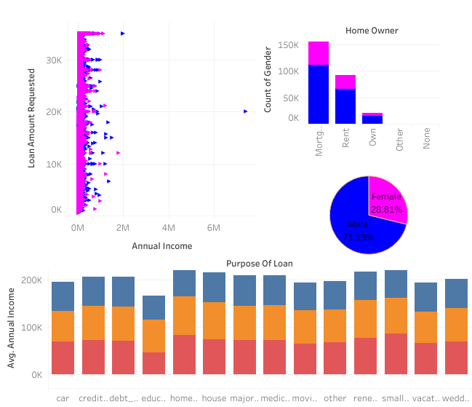
03
Exploratory Data Analysis
Note: Better you zoom of the graphs
2
1st Graph : Count of Gender in data loan
2nd Graph : Home owner each gender Loan
3rd Graph : Dependency Annual Income with Loan Amount by Gender
4th Graph : Averge Annual Income with Purpose of Loan by Income Verified
3
1
4

Slide 6
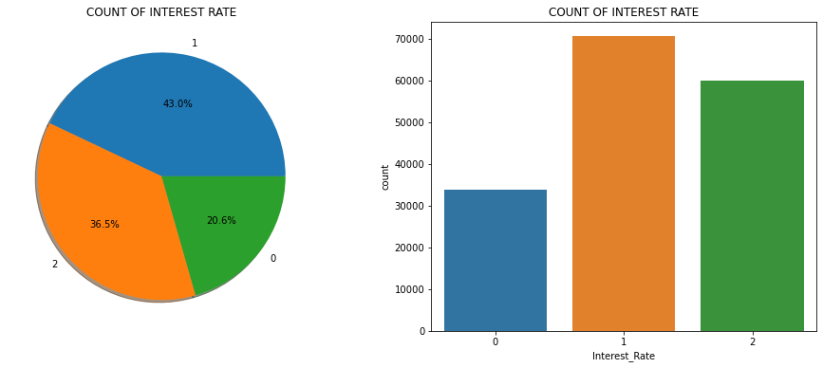
04
Target Label
Note: Better you zoom of the graphs

Slide 7
05
Data Preprocessing
Note: Better you zoom of the graphs
SPLITTING DATASET
HANDLING MISSING VALUES
HANDLING OUTLIERS
FEATURE SELECTION
OVERSAMPLING
SCALING
DIMENSIONALITY REDUCTION
MODEL DEFINITION
ENCODING

Slide 8
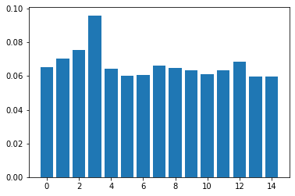
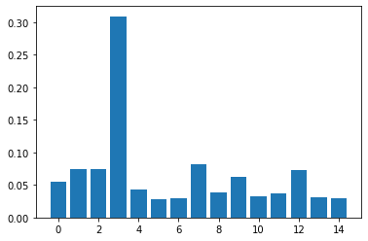
06
Model Training and Model Evaluation
Note: Better you zoom of the graphs
Train Results (Random Forest Classifier)
 | Precision | Recall | F1-Score | Support
0 | 1.00 | 1.00 | 1.00 | 32627
1 | 1.00 | 1.00 | 1.00 | 68253
2 | 1.00 | 1.00 | 1.00 | 57700
Accuracy |  |  | 1.00 | 158580
macro avg | 1.00 | 1.00 | 1.00 | 158580
weighted | 1.00 | 1.00 | 1.00 | 158580
A
RANDOM FOREST
Feature
Importance
Train Results (XGBoost Classifier)
 | Precision | Recall | F1-Score | Support
0 | 0.61 | 0.23 | 0.34 | 32627
1 | 0.54 | 0.70 | 0.61 | 68253
2 | 0.62 | 0.61 | 0.62 | 57700
Accuracy |  |  | 0.57 | 158580
macro avg | 0.59 | 0.52 | 0.52 | 158580
weighted | 0.58 | 0.57 | 0.56 | 158580
EXTREME GRADIEN BOOSTING
B
Feature
Importance
3.4
Gender

Slide 9
08
Conclusion
Note: Better you zoom of the graphs
Understanding Data Set
Data Test did not have column target `Interest_Rate`, so I can't compare the result between train and test result over fit or under fit or perfect
The model just do training model in Data Train
There are anomali data in Data Train and Data Test
I drop column `Loan_ID` that's primary key, unfortunately that is useless for modeling
Column Target is 0, 1, and 2 after replaced, have some imbalanced data, expetation for improvement need oversampling to have best result, but the real is no needed.
01
Modeling
As well as my own template, i do modeling sequence start with:
- Data Processing
- Data Training
- Cross Validation
- Hyperparameter tuning with GridSearchCV.
- Model Evaluation
- Make feature importance
I'm failed to do Cross Validation because over time until 5 hours then i dont do it again but coding still exist as my own template.
Did hyperparameter tuning was bad result and running time was over time until 20 hours 51 minutes
From that i decide modeling manually with choose algorithms are Random Forest and Extreme Gradient Bossting (XGBoost) with default parameters.
Result is more better default parameter with algorithm Random Forest the classification report shows all 100%
Feature importance also shows equally distributed each feature for algorithms Random Forest and that was very good.
Then I decide save model Random Forest to predict Data Test for the new label base on result classification is good.
02
Improvement
Random Forest have classification report shows all 100% make me suspicious, because parameter is default. Then suggested for improvement algorithm are:
We should know best algortihm with crosss validation again
Then we know that, we do hyperparameter tuning with many parameters inside to looking for best params
After that training again with improvement best parameter
We got prediction `Interest_Rate` in Data Test, we should need to re-training and re-tuning hyperparameters for Data Train and Data Test to looking for comparison result between Data Train and Data Test, it shows Over Fit or Under Fit, that's clearly modeling.
03
3.5
Economics Data

Slide 10
2022
THANK YOU
Suitable for application for becoming a Data Science staff.
Reporter: Enggar Kristian

